Slide 1
Tabular Data
Notes:
Hello again.
I’m Matthew Renze, data science consultant, author, and public speaker.
Welcome back to this introductory course on data for data science.
In this module, we’ll learn about tabular data …
… and how we can extract information from tables of data using queries.

Slide 2
How do we extract information from data?
Notes:
How do we extract information from data?
What’s the best way to structure our data to extract information?
And how do we answer our questions once our data has been structured?

Slide 3

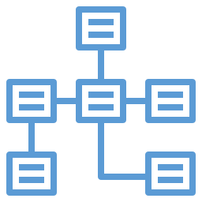

Overview
Tabular Data
Observations
Variables
Relationships
Queries
Notes:
To answer these questions, we’re going to learn about tabular data and how we extract information from tables using queries.
[1] First, we’ll learn about tabular data, data that are stored in the rows and columns of a table.
[2] Next, we’ll learn about observations, records of observable phenomena, which are stored in the rows.
[3] Then, we’ll learn about variables, values that vary for each observation, which are stored in the columns.
[4] Next, we’ll learn about relationships that can exist between observations in multiple tables.
[5] Finally, we’ll learn about queries, statements that allow a computer to answer a question using a table of data.

Slide 4

Tabular Data
Notes:
Tabular data are the most common form of structured data that we use for analysis in data science.
But what are tabular data and how do we organize our data in this way?

Slide 5
Tabular Data
Data organized into a table
Table is a grid of data
Column must be same type
Row can contain many types
Notes:
[1] Tabular data are data organized into a table.
The table provides the data with structure.
[2] A table, is a two-dimensional grid of data.
However, unlike a matrix, which we saw earlier, all of the elements in a table *do not* need to be all of the same data type
[3] Rather, all data *in each column* must be the same data type, which we refer to as homogenous data.
[4] However, all data *in a row* can have different data types, from column to column, which we refer to as heterogenous data.

Slide 6
Tabular Data
Patients
Name | Gender | Age
Bill | Male | 21
Miko | Female | 15
Juan | Other | 45
Notes:
For example, imagine we have a table of patients at a hospital.
We would have a set of rows (one for each patient) and a set of columns, (one for each attribute of the patient).
Each element of data in a column must be the same data type.
For example,
- all of the names must be character strings.
- all of the genders must be enumerations of male, female, or other genders.
- all ages must be integers…
- and so one.
However, the each row contains elements of various data types.
For example,
- the name “Bill” is a character string,
- the gender “Male” is an enumeration
- and the age “21” is an integer
As we can see, each column contains only a single data type; however, each *row* can contain multiple data types.

Slide 7
Tabular Data
Observations
Variables
Relationships
Notes:
In data science, tabular data can be broken down into three main components:
[1] Observations – which we locate on the rows of a table
[2] Variables – which we locate on the columns of a table
[3] and Relationships – which connect data in one table to data in another table
We’ll discuss each of these components, in more detail, next.

Slide 8

Observations
Notes:
Data science is founded upon making observations of the world around us.
But what are observations and how do we record them in tabular data?

Slide 9
Observations
Recording
On the rows
Notes:
[1] An observation is a recording of the qualities and quantities of an observable phenomenon in the natural world.
This includes what we can see, hear, feel, or measure with sensors.
[2] In data science, we record observations on the rows of a table.
The rows are the horizontal groups of data that are contained within the table.

Slide 10
Observations
Recording
On the rows
Same observation
One per row
Vital Signs
Date | Pulse | Temp.
2020-01-01 | 89 | 39.0
2020-01-02 | 85 | 38.5
2020-01-03 | 80 | 37.2
Notes:
For example, imagine that we are recording the vital signs of a patient at a hospital.
For each observation, we would record the date of the observation, the patient’s heart rate, their temperature, and other vitals.
Each of these observations would be recorded on a separate row.
[3] What is important to note is that all of the elements in a row of data belong to the same observation.
For example, a row of data can be an observation of a person, a place, a thing, or a set of sensor readings at a specific time.
[4] In data science, we want each row to contain one and only one observation.
Essentially, each row should record one, and only one, person, place, or thing begin observed at a given time.

Slide 11
Observations
Rows
Tuples
Records
Notes:
Outside of data science, the rows of a table of data go by various names.
[1] First, you may hear them simply referred to as “rows”, for, well, obvious reasons, I guess.
[2] In computer science, they are often referred to as a tuples (or a tupples), which is a mathematical term for a list of data.
[3] Or you may often hear them referred to simply as “records”, because they store a recording of an observation, entity, or transaction of some kind.
No matter what they are called, observations should always be represented as rows in tabular data.

Slide 12

Variables
Notes:
The world is in a constant state of change; things vary from one observation to the next.
But how do we record these variations across observations in data science?

Slide 13
Variables
Value that changes
On the columns
Notes:
[1] A variable is placeholder for a value that changes.
We call them “variables” because their values “vary” across each observation.
[2] In data science, we store variables on the columns of a table.
Columns are the vertical groups of data that are contained within the table.

Slide 14
Variables
Value that changes
On the columns
Same data type
Vital Signs
Date | Pulse | Temp.
2020-01-01 | 89 | 39.0
2020-01-02 | 85 | 38.5
2020-01-03 | 80 | 37.2
Notes:
For example, imagine we’re recording vital signs for a patient at a hospital.
Our variables might be:
- the date and time of the observation,
- the patients heart rate measured by their pulse,
- and their body temperature at the time of the observation.
[3] What is most important, is that all of the elements in a specific column must be of the same data type, scale, and unit of measure.

Slide 15
Variables
Value that changes
On the columns
Same data type
Vital Signs
Date | Pulse | Temp.
1/1/2020 | 89 | 39.0
2020-01-02 | Normal | 38.5
2020-01-03 | 80 | 99°F
Notes:
For example:
- we don’t want our dates to be stored using different date formats.
- we don’t want our heart rate data to be stored using two different data types
- and we don’t want our temperature to use both Celsius and Fahrenheit units of measure.

Slide 16
Variables
Value that changes
On the columns
Same data type
One per column
Vital Signs
Date | Pulse | Temp.
2020-01-01 | 89 | 39.0
2020-01-02 | 85 | 38.5
2020-01-03 | 80 | 37.2
Notes:
Instead, we want all of the data in the column to use the same data type, same scale, and same units of measure.
[4] Finally, we want one and only one variable per column of data.
We don’t want to try placing multiple variables in a single column.

Slide 17
Variables
Value that changes
On the columns
Same data type
One per column
Vital Signs
Date | Blood Pressure
2020-01-01 | 139/89
2020-01-02 | 128/85
2020-01-03 | 120/80
Notes:
For example, if we’re recording blood pressure, we record two numbers:
- the systolic blood pressure
- and the diastolic blood pressure
We don’t want to record both of these measures in a single column, like we commonly see it written in our medical history.

Slide 18
Variables
Value that changes
On the columns
Same data type
One per column
Vital Signs
Date | Systolic | Diastolic
2020-01-01 | 139 | 89
2020-01-02 | 128 | 85
2020-01-03 | 120 | 80
Notes:
Instead, we would prefer to have a single column for systolic blood pressure and a single column for diastolic blood pressure.
Storing each variable in a separate column allows us to store, process, and analyze the data more efficiently.

Slide 19
Variables
Columns
Attributes
Properties
Notes:
Outside of data science, the columns of a table go by various names.
[1] First, you may simply hear them referred to as “columns”.
[2] In addition, you may also hear them referred to as “attributes”.
[3] Or in some cases, as “properties”.
No matter what they are called, variables should always be represented as columns in tabular data.

Slide 20
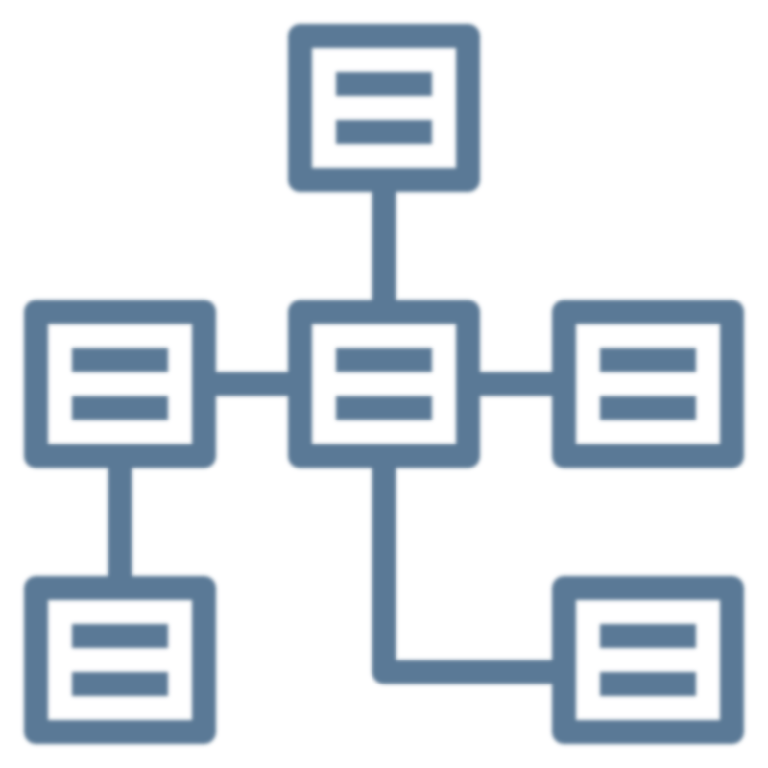
Relationships
Notes:
Everything is related in some way, shape, or form.
So how do we represent relationships in data science?

Slide 21
Relationships
One table per type
All related data
Multiple tables
Notes:
[1] In data science, we want each table to contain a single type of observation or type of entity.
For example, we want to keep a list of our patients in one table and a list of our doctors a separate table.
[2] We want each table to only contain data that are related to one another in a highly cohesive way.
We don’t want to compress multiple types of observations or multiple types of entities into a single table.
So, we create a separate table for each type of observation or entity.
[3] This means that our dataset often needs to be split up into multiple tables.
When we have multiple tables of data, the observations in one table can be related to the observations in another table.

Slide 22
Relationships
Relationship
Primary key
Foreign key
Notes:
[1] A relationship is a way to express how a row of data in one table is related to a row of data in another table.
We create relationships between rows using “keys”.
[2] We use a primary key to uniquely identify an observation in it’s source table.
[4] Then we use a foreign key in observations in a second table to refer back to the original observation in the source table.

Slide 23
Relationships
Patients
Vital Signs
Name | Gender | Age
Bill | Male | 21
Miko | Female | 15
Juan | Other | 45
Patient | Date | Temp.
Bill | 2020-01-01 | 37.1
Miko | 2020-01-01 | 38.0
Miko | 2020-01-02 | 36.5
Notes:
For example, imagine that we have two tables:
[1] – First, we have a table of patients.
It contains their names, genders, dates of birth, and more.
[2] – Second, we have a table of all of our patient’s vital signs.
It contains observations of the patient’s temperature, heart rate and more for a specific day.
We could duplicate the patient’s name and other personal data for each recording of their vital signs.
However, it’s much more efficient to store the patient’s data once and then simply refer back to that data from the vital-signs table.
We do this by creating a primary key and a foreign key.

Slide 24
Relationships
Patients
Vital Signs
ID | Name | Gender | Age
 | Bill | Male | 21
 | Miko | Female | 15
 | Juan | Other | 45
Patient | Date | Temp.
Bill | 2020-01-01 | 37.1
Miko | 2020-01-01 | 38.0
Miko | 2020-01-02 | 36.5
1
2
3
Notes:
First, in our patients table, we create a column to store our primary key.
[1] Then we create a primary key for each unique patient in our patients table.
We use a 1 for Bill, a 2 for Miko, and so on.
This primary key uniquely identifies each patient in our system.

Slide 25
Relationships
Patients
Vital Signs
ID | Name | Gender | Age
1 | Bill | Male | 21
2 | Miko | Female | 15
3 | Juan | Other | 45
Patient ID | Date | Temp.
 | 2020-01-01 | 37.1
 | 2020-01-01 | 38.0
 | 2020-01-02 | 36.5
1
2
2
Notes:
Next, in our vital-signs table, we create a column for our foreign key
[2] We populate this column with the unique identifier that points back to the primary key.
We use a 1 for Bill, a 2 for Miko, and so on.

Slide 26
Relationships
Patients
Vital Signs
ID | Name | Gender | Age
1 | Bill | Male | 21
2 | Miko | Female | 15
3 | Juan | Other | 45
Patient ID | Date | Temp.
1 | 2020-01-01 | 37.1
2 | 2020-01-01 | 38.0
2 | 2020-01-02 | 36.5
Notes:
Now we can navigate the relationship forward from any patient to get their vital signs.
Or we can navigate the relationship backwards from a vital sign to get the patient’s name and information.
Relationships allow us to connect data from table to table in many ways.
However, we’ll have to defer these various types of relationships to a more advanced course on data science.

Slide 27

Queries
Notes:
How do we extract information from tabular data?
The answer, is a query!

Slide 28
Queries
Question
Programming language
Structured Query Language
Notes:
[1] A query is computer representation of a question we want answer using a table of data.
They allow us to ask questions of the data and return answers as results.
[2] Queries are created using programming languages.
More specifically, we use a special type of programming language called a query language.
[3] The most popular query language is Structured Query Language (or SQL for short).
However, you can also perform queries using other programming languages like Python and R.

Slide 29
Queries
Question
SQL Query
What was Bill’s average body temperature over the past 5 years?
select avg([Temperature])
from [Vital Signs]
where [Name] = "Bill"
and [Date] >= "2015-01-01"
Notes:
[1] For example, let’s say we want to answer the question: “What was Bill’s average body temperature over the past 5 years”.
[2] We could write this question in the form of a SQL query.
The SQL query allows us to express that we want to:
- select the average temperature
- from the Vital Signs table
- where the patient’s name is “Bill”
- and the date is greater than or equal to January 1, 2015 (which we’re assuming is five years ago).
I’ve intentionally kept this query simple for those of you who have never seen a SQL query before.
However, if you’ve had some experience with SQL, you may see several ways we could improve this query.

Slide 30
Queries
SQL Query
Vital Signs
select avg([Temperature])
from [Vital Signs]
where [Patient Name] = "Bill"
and [Date] >= "2015-01-01"
Date | Name | Temp.
2010-01-01 | Bill | 37.0
2010-01-02 | Miko | 38.5
2010-01-03 | Juan | 38.2
Notes:
When we execute this query,
[1] First, the database will scan all of the records in the Vital Signs table
Next, it will filter out anyone who is not our patient named Bill.

Slide 31
Queries
SQL Query
Vital Signs
select avg([Temperature])
from [Vital Signs]
where [Patient Name] = "Bill"
and [Date] >= "2015-01-01"
Date | Name | Temp.
2010-01-01 | Bill | 37.0
2015-01-01 | Bill | 36.9
2020-01-01 | Bill | 37.1
Notes:
Then, it will filter out any row that is older than January 1, 2015 (i.e. five years before today’s date)

Slide 32
Queries
SQL Query
Vital Signs
select avg([Temperature])
from [Vital Signs]
where [Patient Name] = "Bill"
and [Date] >= "2015-01-01"
Date | Name | Temp.
2015-01-01 | Bill | 36.9
2020-01-01 | Bill | 37.1
Notes:
Next, it will select just the Temperature column from the Vital Signs table.

Slide 33
Queries
SQL Query
Vital Signs
select avg([Temperature])
from [Vital Signs]
where [Patient Name] = "Bill"
and [Date] >= "2015-01-01"
Temp.
36.9
37.1
Average
Notes:
[1] Finally, it will compute the average of the remaining temperature values.

Slide 34
Queries
SQL Query
Result
select avg([Temperature])
from [Vital Signs]
where [Patient Name] = "Bill"
and [Date] >= "2015-01-01"
37.0
Notes:
The computer will then return this value as a result.
As we can see, the result of executing this query is 37 degrees Celsius.

Slide 35
Queries
Question
Query
Result
What was Bill’s average body temperature over the past 5 years?
select avg([Temperature])
from [Vital Signs]
where [Patient Name] = "Bill"
and [Date] >= "2015-01-01"
37.0
Answer
It was 37°C.
Notes:
Essentially, this is how we get from a question to an answer, using a query.
[1] We start with a question in our natural language,
[2] - we construct a SQL query to express that question to the computer,
[3] - we execute the query which returns a result,
[4] - and then we express that result in the form of an answer to the question.
Queries are the primary tool used for extracting information from data in data science.

Slide 36
Summary
Notes:
In this module, we learned about tabular data… and how we can extract information from tables of data using queries.

Slide 37
Summary
Tabular Data
Observations
Variables
Relationships
Queries
Notes:
[1] First, we learned that tabular data are data that are organized into tables consisting of rows and columns.
[2] Next, we learned that observations are records of observable phenomena, which are stored on the rows.
[3] Then, we learned that variables contain values that vary across each observation, which are stored on the columns.
[4] Next, we learned that we can create relationships between observations in two or more tables by using primary and foreign keys.
[5] Finally, we learned that queries allow us to ask questions of tabular data and return answers in the form of information.
In the next module, we’ll learn about the data life cycle… the journey of data as it is transformed from raw data to actionable insight.

